Slide 1

Force Quit
by
Trinity
By Zoe Lim, Parthan Muralidhran, and Suhana Gupta

Slide 2

Problem Statement
Help smokers to quit smoking by :
Finding nearby Quit Centres
Tracking their progress by using a counter
Notes:
It is important for our project to have a concise description of the issue that needs to be addressed by the team before we try to solve the problem.
Force Quit wants to help smokers find nearby quit centres and also track their progress by using a counter to count the number of days since they’ve stopped smoking
And using a mobile application, we hope people can easily identify and locate a quit centre

Slide 3




Requirement Elicitation
Requirement Analysis
Design & Implementation
Testing
Notes:
Software Engineering brings us through 4 main phases to resolve our problem statement. Namely, REQUIREMENT ELICTATION, REQUIREMENT ANALYSIS, DESIGN/IMPLEMENTATION and lastly TESTING.

Slide 4



Requirement Elicitation
Notes:
In Requirement Elicitation we place ourselves in the shoes of our stakeholder to obtain information that needs to be dealt with.

Slide 5
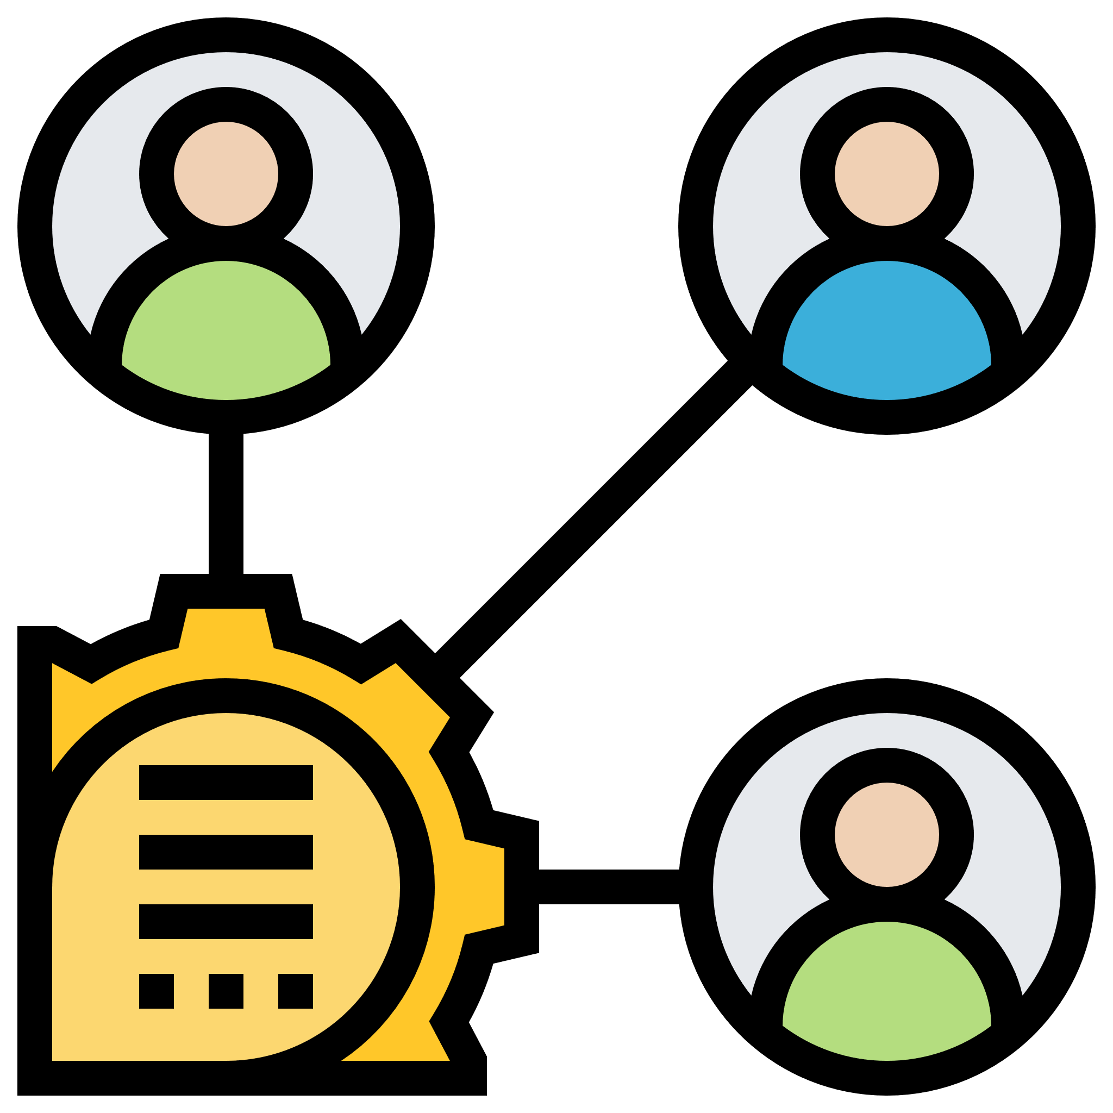
Who?
Stakeholders
Smoker
Developer
Tester
Notes:
First we identify the stakeholders, and asking ourselves, we identify the smoker as the most important stakeholder.

Slide 6

What?
Identify required features
Find needs of the stakeholders
Examine existing mapping services
Notes:
Next we think of what features are required and also the needs of the stakeholders.
We also examine existing solutions similar to our app.

Slide 7
How?
Functional Requirement
Non-functional requirement
Use Case
Data Dictionary
UI Prototype
Notes:
We do so by identifying the requirements, use cases and UI prototype

Slide 8





Required Features
Track their progress using a counter
Search quit centre by name
View all quit centres in map view
View all quit centres in list view
View quit centre information in detail
Notes:
Through these steps we figure out the required features as shown on screen.

Slide 9

Requirement Analysis
Notes:
After eliciting requirements through the various methods applied, we analyse the information to lay the ground for the Design & Implementation

Slide 10



Actors
User
Google
Data.gov.api
Notes:
Before we dive into the conceptual models, we will go through the use case models to aid in the analysis.

Slide 11
Cases
Search
Quit Centre
Notes:
To avoid overwhelming you guys we will only focus on the most important Use Case which is SEARCH quit centre

Slide 12
Use Case Model
Search
Quit centre
wants to
provide data
Data.gov.api
User
Notes:
Firstly, we use the data from data.gov.api to find the locations and details of each quit centre. Then, we provide a function for the user to search for a particular quit centre.
Searching a particular quit centre will return details such as the quit centre’s telephone number, address and postal code.

Slide 13
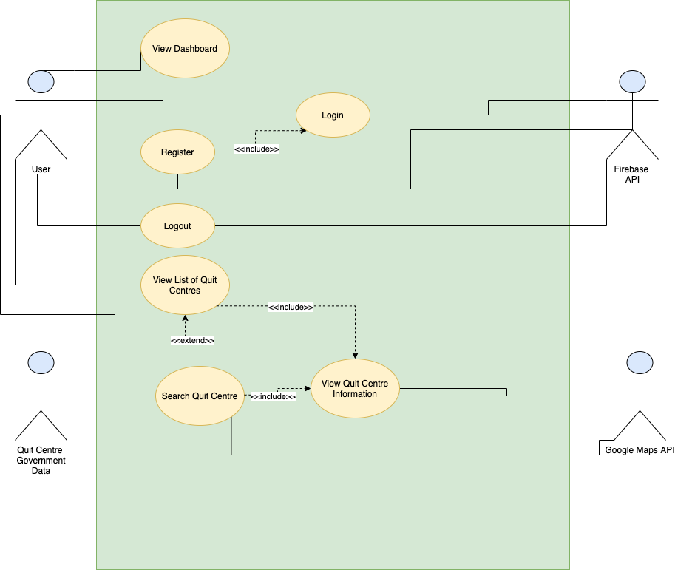
Notes:
<briefly show this> this is our use case diagram

Slide 14
Conceptual Model
MapUI
QuitCentreUI
MapController
QuitCentreController
Quit Centre
Notes:
For us to complete the (SEARCH quit centre) use case scenario the User should be able to do so in the MapUI & quit centre UI boundary classes.
The respective control classes will be accessed before information can be retrieved from the quit centre entity class.
Note MapController shares a dependency relationship with quit centre Controller such that MapUI can still access the quit centre entity class. With this model, low coupling and high cohesion is enforced

Slide 15
Conceptual Model
<<entity>>
QuitCentre
address : string
location : geopoint
postcode : string
quitcentrename : string
tel no : string
Quit Centre
Notes:
While a boundary class diagram does not show the entire picture of the model, an entity class diagram shows the in-depth view of the classes.

Slide 16
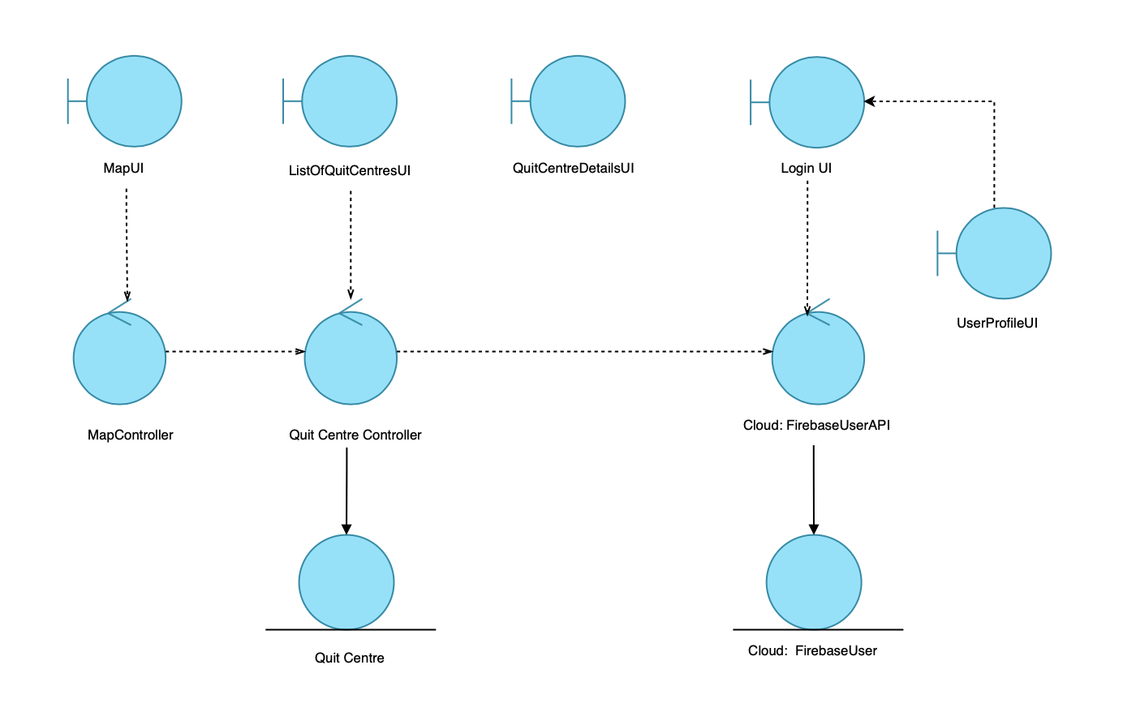
Notes:
<briefly show> this is our boundary class diagram

Slide 17
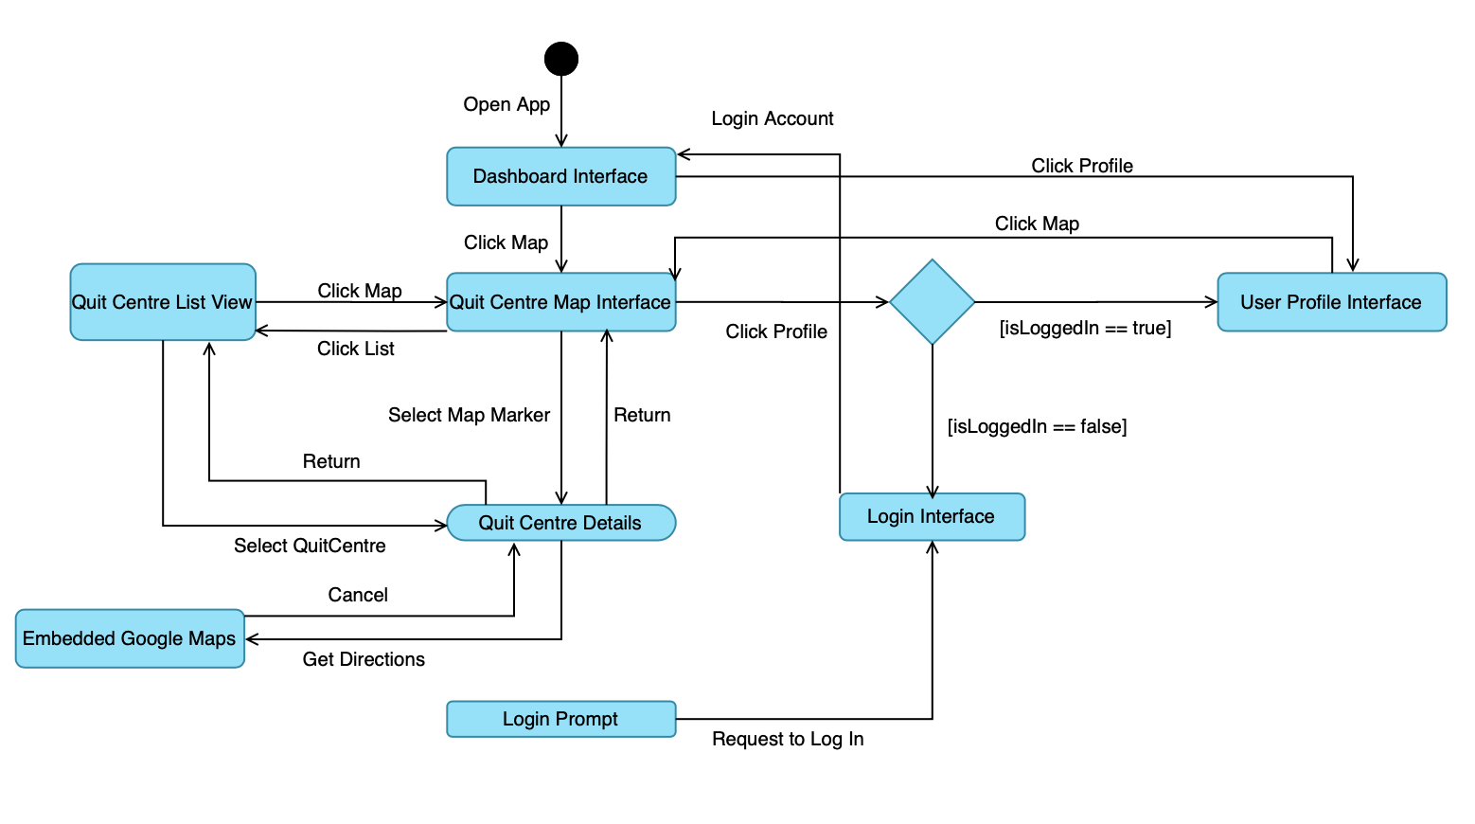
Dynamic Model
Notes:
With our conceptual model done, we deduce the various behavioural states and changes through our dynamic model.
The state diagram helps us to ensure that the program changes according to plan when developing the different modules for it.

Slide 18
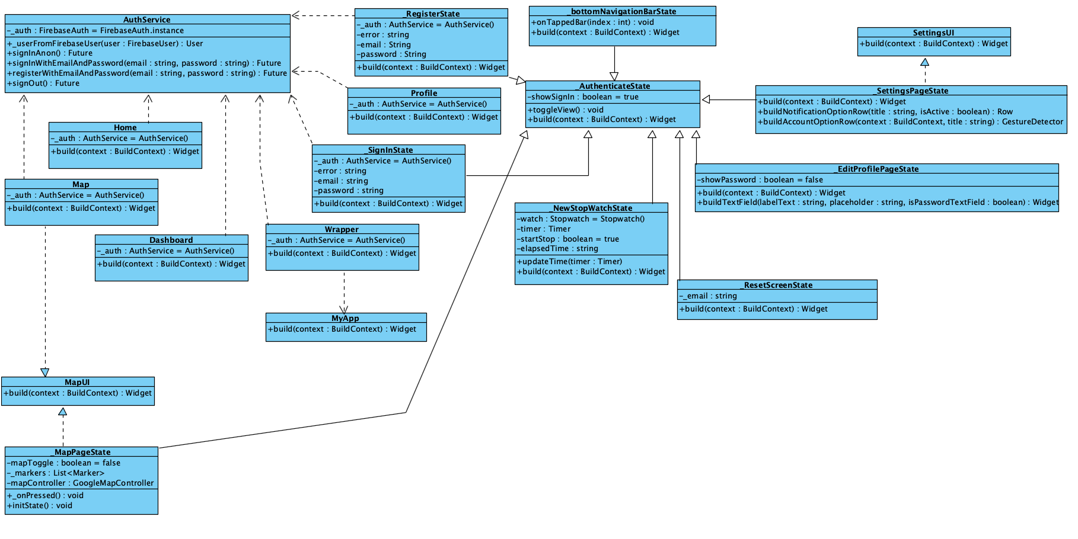
Class entity diagram
Notes:
With our conceptual model done, we deduce the various behavioural states and changes through our dynamic model.
The state diagram helps us to ensure that the program changes according to plan when developing the different modules for it.

Slide 19
Design
&
Implementation
Notes:
Now, we move on to design and implementation.

Slide 20
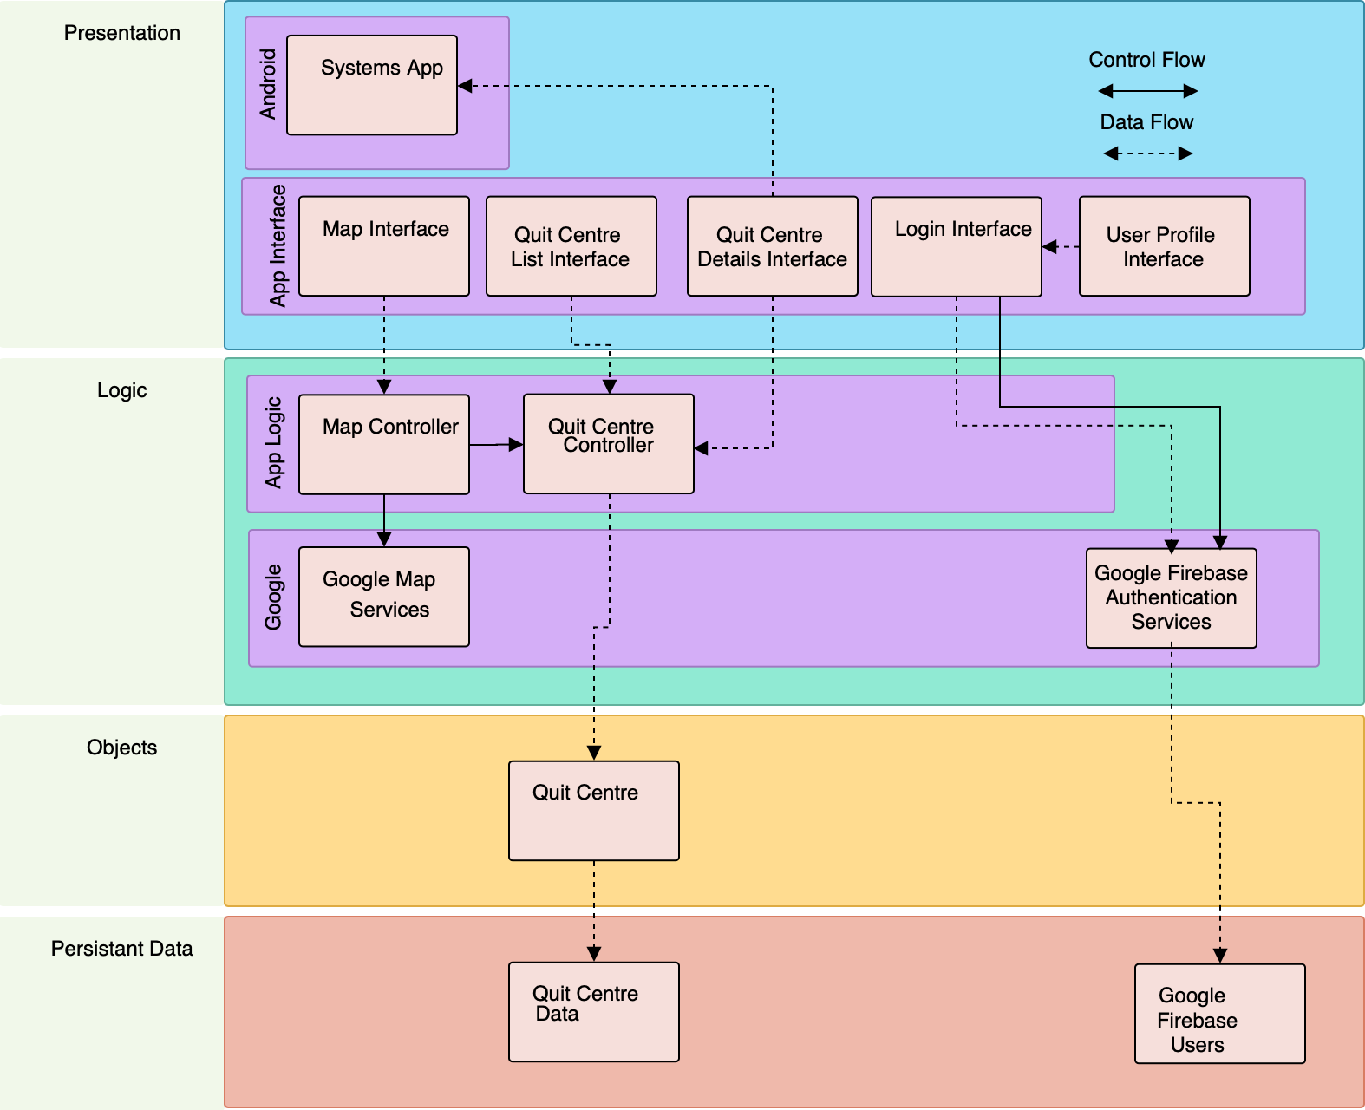
System Architecture
Notes:
We decide to proceed with a layered architecture as it has its advantages.
We do so by separating the user interface from the application logic, and the application logic from data access logic.

Slide 21


Advantages
Loose Coupling
Modularity
Notes:
Through a layered approach, it enables loose coupling between the various modules.
This way the application is also modular and can be independently developed, deployed and maintained.

Slide 22



API’s Used
Notes:
We decide to focus on developing an Android application using flutter and dart as our front-end.
We also used Google API to develop our application:
Google Maps -> for the geographic maps and location.
To handle our backend needs, we utilised the Firebase cloud platform.
This helps to reduces the hassle of tinkering and setting up a conventional database and backend logic.

Slide 23
Demo
Notes:
<demo live here>

Slide 24
Testing

Slide 25
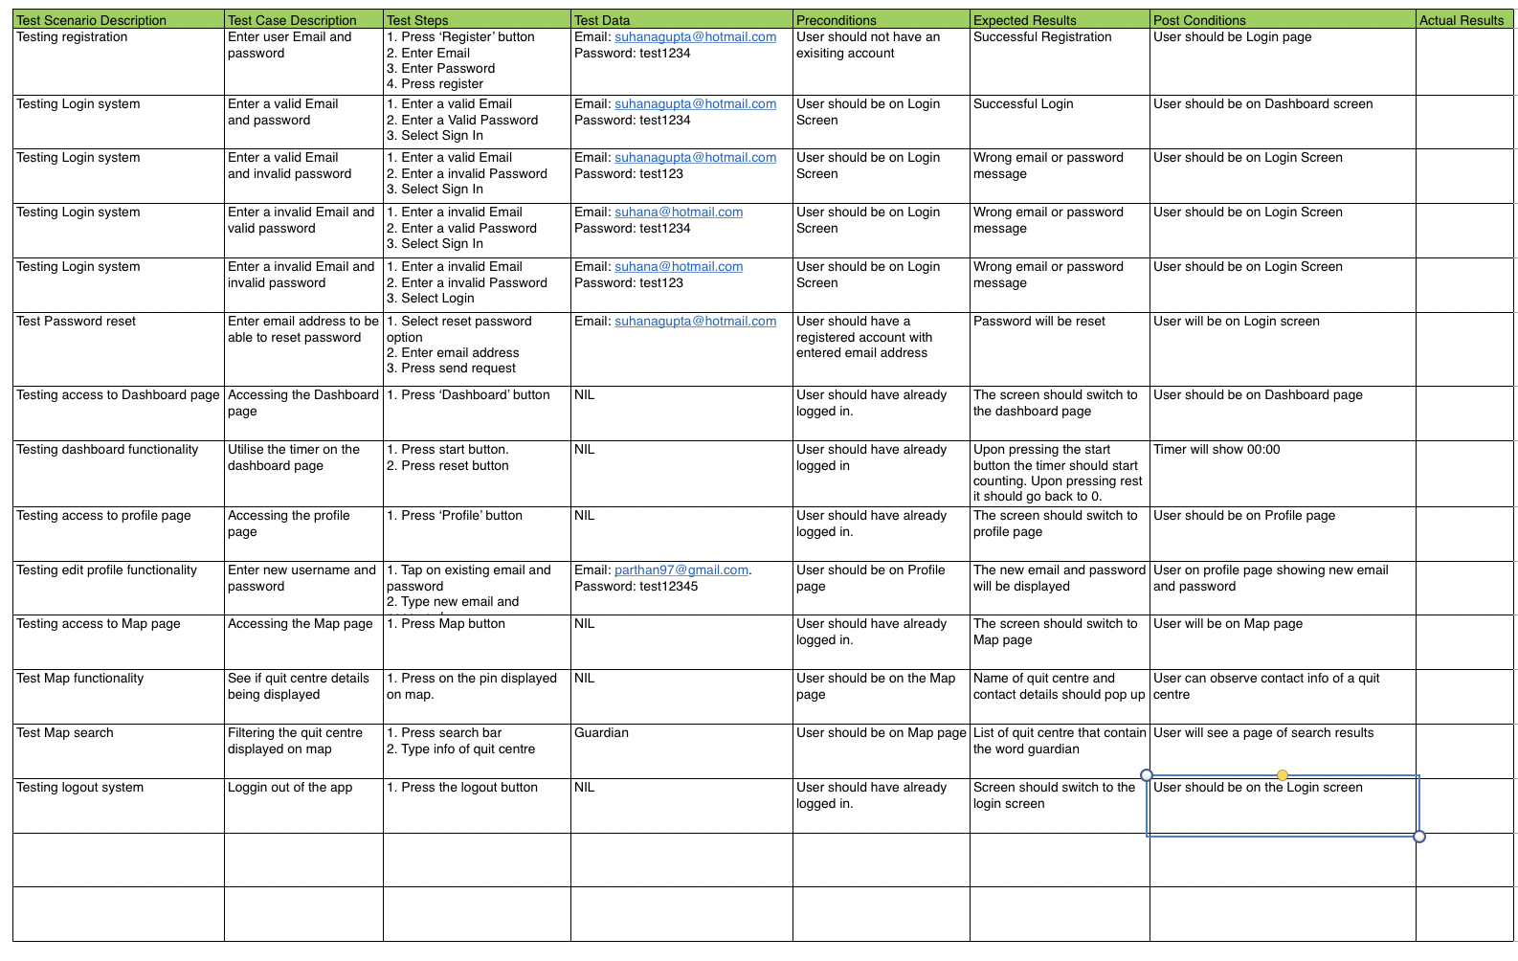
Blackbox Test

Slide 26
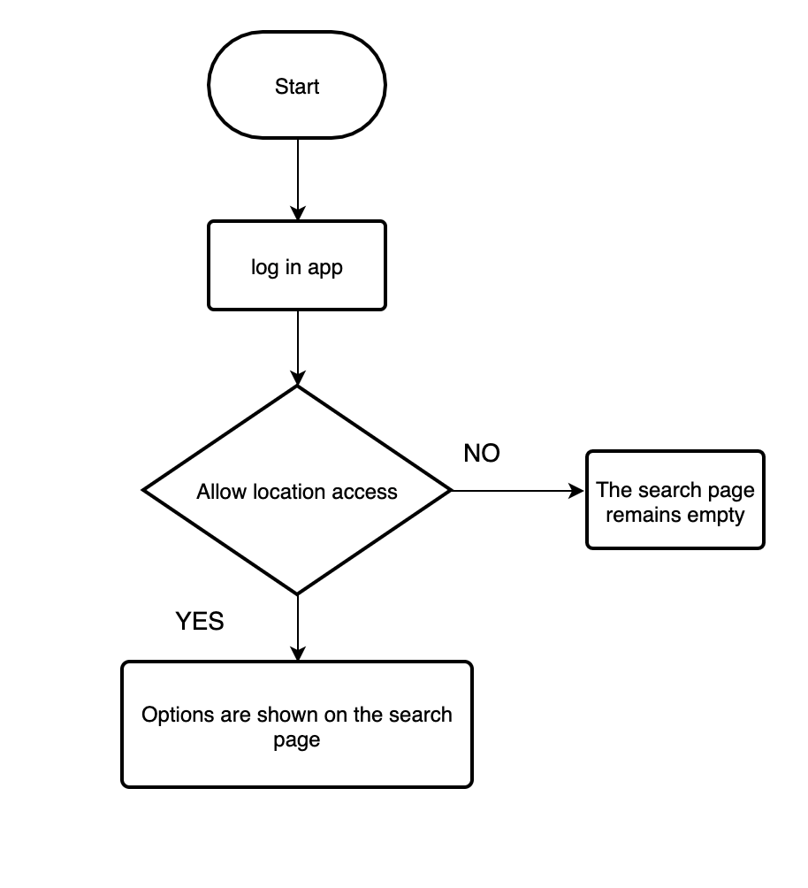
Whitebox Test

Slide 27



Recommendations
Match user to a Quit Coach
Count other statistics such as
oxygen levels & money saved
Appointment booking
Notes:
Lastly, some of the recommendations of our app would include :
Counting other stats like oxygen levels and money saved
Enable further support by matching the user with a quit coach
Appointment booking for the quit centre

Slide 28
Thank you!

